Slide 1
Updates on the Feed-in Tariff Allowance (FIT-All)

Slide 2
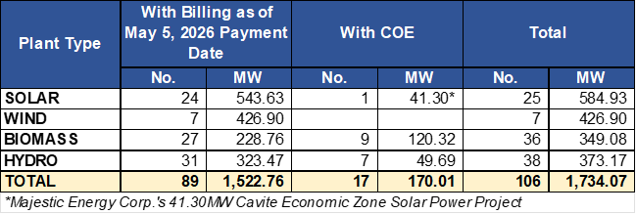
RE PLANTS UNDER THE FIT
As of May 5, 2026

Slide 3
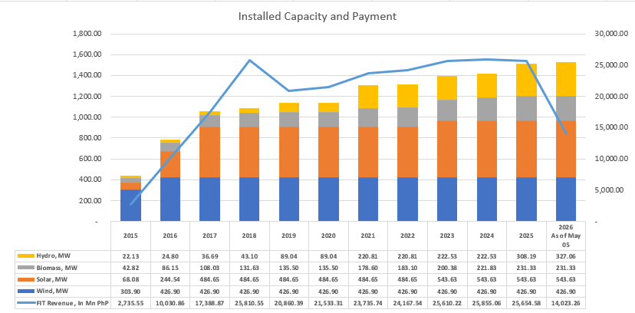
PAYMENT TO RE DEVELOPERS
After May 5, 2026 Payment Date
PAYMENTS MADE = PhP237,393.50Mn, 97.96%
OUTSTANDING PAYABLE = PhP4,955.58Mn, 2.04%
Installed
Capacity,
In MW
Payment,
In Mn PhP
Note: The spike of payment in 2018 is due to the payment of interest charges for the delayed payment of FIT Revenues caused by insufficiency of fund.

Slide 4
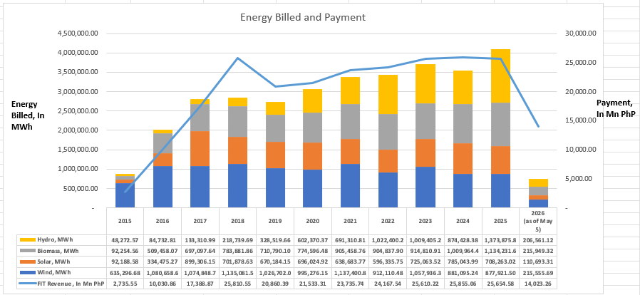
PAYMENT TO RE DEVELOPERS
After May 5, 2026 Payment Date
PAYMENTS MADE = PhP237,393.50Mn, 97.96%
OUTSTANDING PAYABLE = PhP4,955.58Mn, 2.04%
Energy Billed, In MWh
Note: The spike of payment in 2018 is due to the payment of interest charges for the delayed payment of FIT Revenues caused by insufficiency of fund.

Slide 5
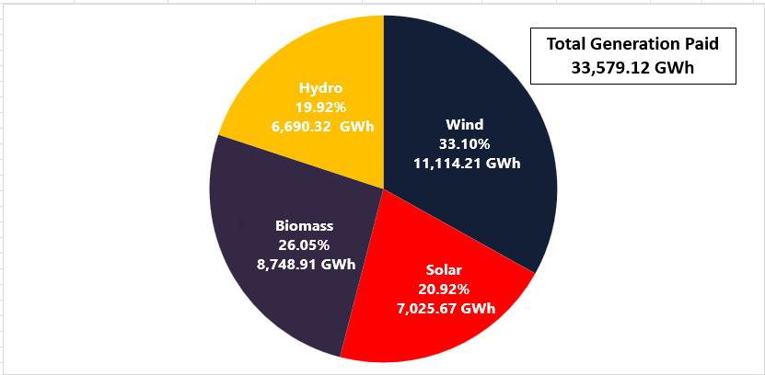
BILLED GENERATION, GWh
After May 5, 2026 Payment Date
Hydro, 16.61%
4,005.94 GWh
Wind, 36.45%
8,791.89GWh
Biomass, 25.29%
6,009.05 GWh
Solar, 21.65%
5,223.71 GWh

Slide 6
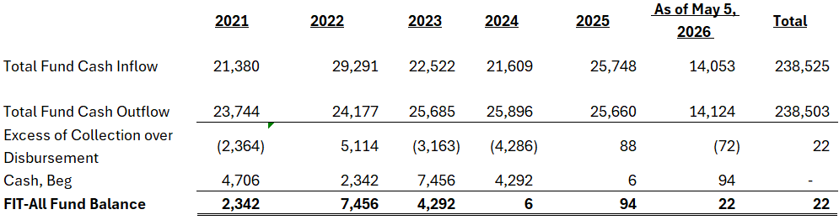
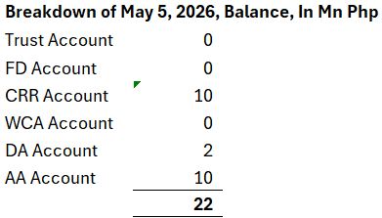
FIT ALL FUND CASH FLOW, In Mn Php
After May 5, 2026 Payment Date
Note: Cash flows include both CRR and FIT-All, as of May 5, 2026

Slide 7
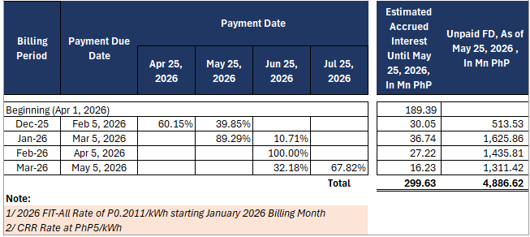
SCHEDULE OF FIT DIFFERENTIAL (FD) PAYMENTS, In Php
After May 5, 2026 Payment Date

Slide 8
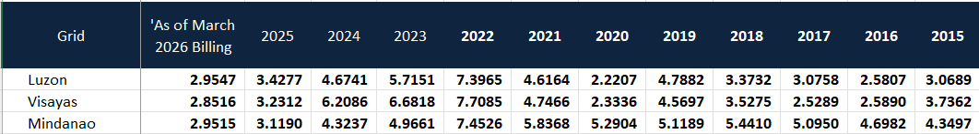
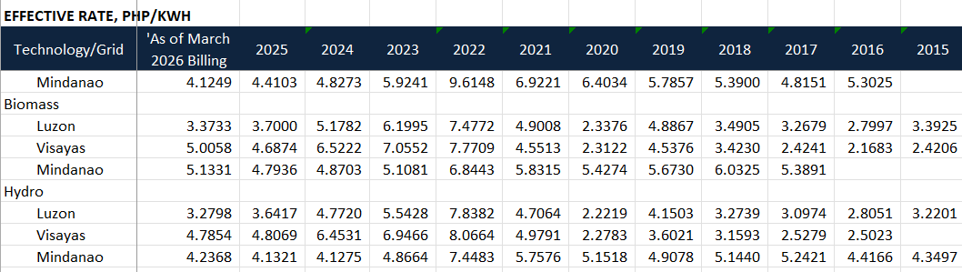
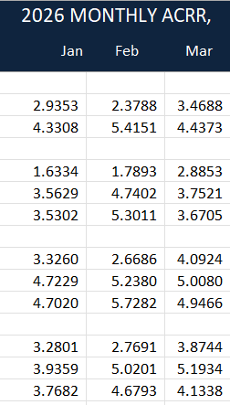
EFFECTIVE COST RECOVERY RATE, PhP/kWh

Slide 9
FIT-ALL RATE APPROVAL

Slide 10
RE PAYMENT AGREEMENT (REPA) STATUS
As of May 5, 2026

Slide 11
Updates on the Green Energy Auction Allowance (GEA-All)

Slide 12
GEA-ALL RATE APPROVAL
On February 11, 2026, initial remittance to the GEA-All Fund was made by one of the Collection Agents. Total GEA-All collection for the month of February 2026 is PhP58,261,973.88.

Slide 13
RE PLANTS UNDER THE GEAP (WITH REPA)
As of April 6, 2026

Slide 14
END OF PRESENTATION

Slide 15
GREEN ENERGY AUCTION PROGRAM
GEA-1
The GEAP seeks to help the government hit a 35% share of renewables in the power generation mix by 2030.
On 03 November 2021, the DOE issued Department Circular No. DC 2021-11-0036. “Providing the Revised Guidelines for the Green Energy Auction Program in the Philippines.
Notice of Auction for the RE capacity under GEAP totaling 2000 MW was released on 09 February 2022 and the first auction was conducted on June 17, 2022.
Initial installation targets and the result of the first auction are as follows:
Notice of Award : 24 June 2022
*Based on ERC press statement on May 27, 2022
93.26% subscription, 18 REs

Slide 16
GREEN ENERGY AUCTION PROGRAM
GEA-2
Pursuant to Section 4.12 of Department Circular (DC) No. DC2021-11-0036, titled “ Providing the Revised Guidelines for the Green Energy Auction Program in the Philippines”, the Department of Energy (DOE) through the Green Energy Auction Committee (GEAC) invites all Qualified Suppliers to participate in the Second Green Energy Auction (GEA-2) for Renewable Energy (RE). GEA-2 shall cover the Luzon, Visayas, and Mindanao with the following Installation Targets for delivery dates for the years 2024, 2025, 2026:
29.66% subscription, 105 REs

Slide 17
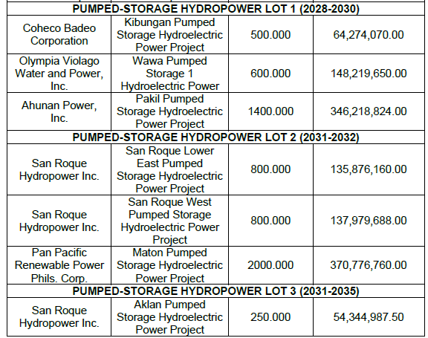
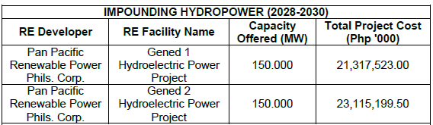
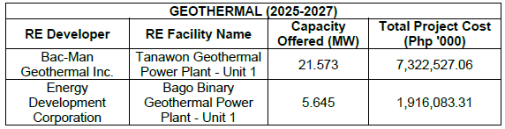
GREEN ENERGY AUCTION PROGRAM
GEA-3
The Auction Proper was conducted on February 11, 2025. On June 25, 2025, the GEA-BEAC issued Bid Bulletin No. 2 for the GEA-3 Winning Bidders as follows:

Slide 18
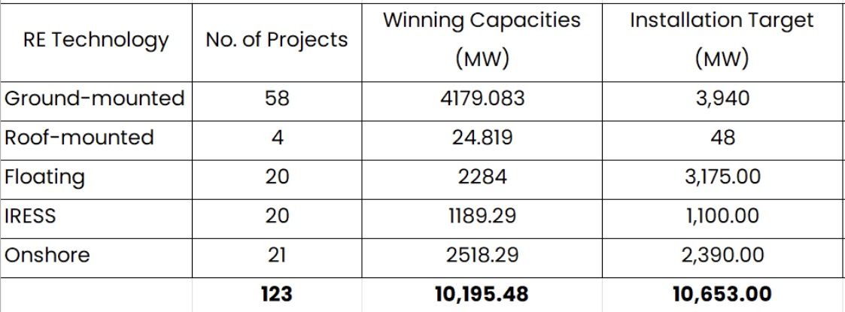
GREEN ENERGY AUCTION PROGRAM
GEA-4
On November 6, 2025, the issued the Notice of Award for GEA-4 summarized as follows:

